Slide 1
Dollars and “Sense”
Funding a Restructuring Region Serving and Supporting Congregational Missions and Ministries

Slide 2
How Giving by Congregations Currently Funds Regional and Area Ministry
CC(DOC) in the U.S. and Canada
Disciples Mission Fund
Anytown Christian Church writes two monthly checks to support Region and Area Ministries
43%
Area (100% stays)
Mid-America Region
Area

Slide 3
Disciples Mission Fund: for every dollar sent today . . .
57% Funds Work of the Wider Church
43% Funds Work of the Region

Slide 4
In 2015 Area and Regional Ministry combined is funded by:
Gifts from congregations to Areas
43% of gifts to Disciples Mission Fund from M-A congregations
Individuals

Slide 5
In 2016 Restructured Regional Ministry will be funded by:
43% of undesignated gifts to Disciples Mission Fund from M-A congregations
100% of designated gifts to Disciples Mission Fund from M-A congregations formerly given to their Area.
Individuals and Interest from endowed funds

Slide 6
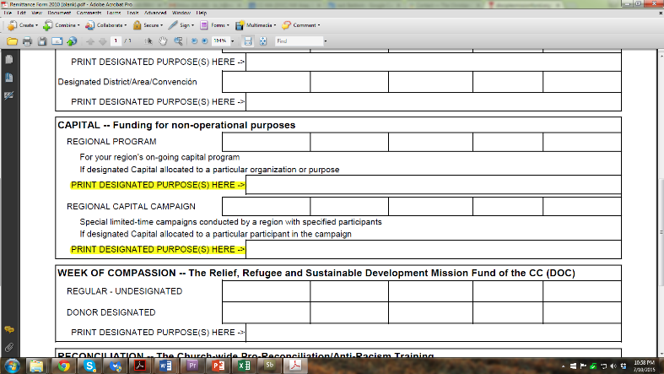
Designated Gifts
On the congregational remittance form there will be a box that reads: Mid-America Ministries (formerly known as Area support)
Congregations can designate an amount in this category that will be sent in full to the Region to help fund missions, ministries and staffing closer to home.
Remittance Forms and valuable information and video is available at:
http://www.disciplesmissionfund.org/

Slide 7
What will that funding accomplish?
19%

Slide 8
Draft proposal of the 2016 Regional Budget (for illustration purposes only)
Total Income: $824,975
$578,350 – anticipated income from congregations (after
$154,000 from Disciples Mission Fund (43% of $358,000 congregations designate only to DMF)
$350,00 formerly given to Areas and now designated as Mid-America Ministries (formerly known as Area support)
$74,350 from other forms of congregational giving
Balance from all other income sources: $246,625

Slide 9
How might this work?
225 Congregations
11,633 average worship attendance (2013)
If every congregation gave $35 designated to DMF and $35.00 to Mid-America Ministries (formerly known as Area support) or $70 per year for every member normally in worship, there would be ample funding to grow support for congregational mission and ministry and support the work of the Christian Church Disciples of Christ!
$70/year

Slide 10
How Giving by Congregations Might Fund Ministry in a Restructuring Region
Disciples Mission Fund (DMF)and Designated Gifts
CC(DOC) in the U.S. and Canada
Anytown Christian Church writes one monthly check to support Region and Ministries closer to home
100% of portion Designated
43% Regular DMF
Funds support for congregational mission and ministry and staffing closer to home
Mid-America Region

